Slide 1
Plotting Atmospheric Data
Handling Big Data with Python
CheckIn Code: 663414

Slide 2
Things you’ll need
CheckIn Code: 663414
VLE page: Advanced Skills and Practical 1 > PC Workshops > Atmospheric Data
Download the following files:
One CSV file of atmospheric data (stoke.csv)
Two python scripts (test.py and atmospheric.py)
Download and open this presentation.
Make sure the .py and .csv files are in the same folder on your M: or H: drive and open that folder in File Explorer.

Slide 3

Google Survey
We’re doing a study to examine how effective this workshop is. If you’d like to participate, please click here or scan this QR code:

Slide 4
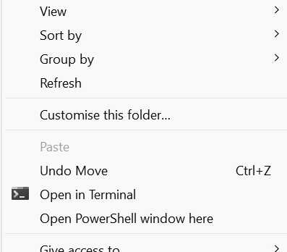

Executing a script
Open the folder containing your python script in File Explorer.
Then open Powershell from the file menu:
Shift + right click
Select “Open Powershell window here”
Check the ‘Working Directory’ is displayed in Powershell.
Write a command that calls the python interpreter, and passes the script name and any arguments:
python3 script.py arguments

Slide 5
Test script
Download the test script (test.py) and move it into your working directory.
This script should run correctly:
python test.py
The script checks you have a working python environment with all the packages installed that we will be using.
Run the test script first when working on a new computer to check the setup!
Open Powershell by right clicking in the folder and selecting “Open in Terminal”.
If this script won’t run, get help to fix your setup.

Slide 6
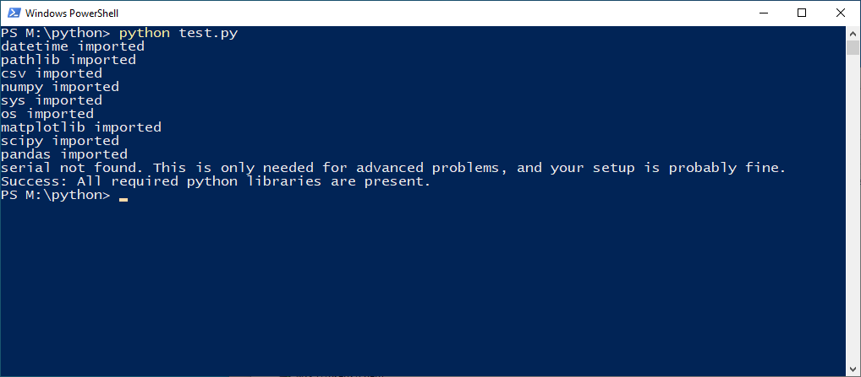
Test script

Slide 7
Atmospheric Chemistry Data
You’ve seen in “Fundamentals of Atmospheric Chemistry” how important accurate measurements of NO, NO₂, and O₃ are.
Today we will look at how complex it can be to visualise and understand big data sets.
We will use measurements of all three compounds made in Stoke from the beginning of 2017 to the end of 2020.
We’ll use Python to visualise this real-world data.

Slide 8
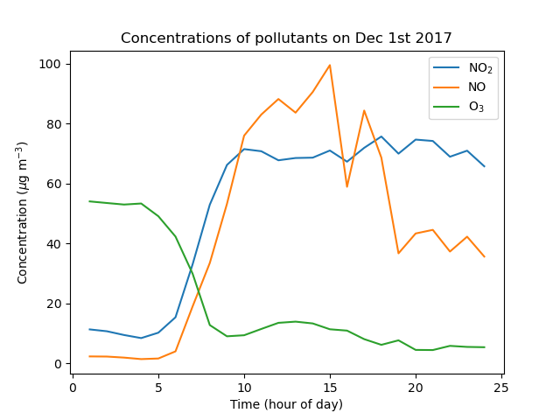
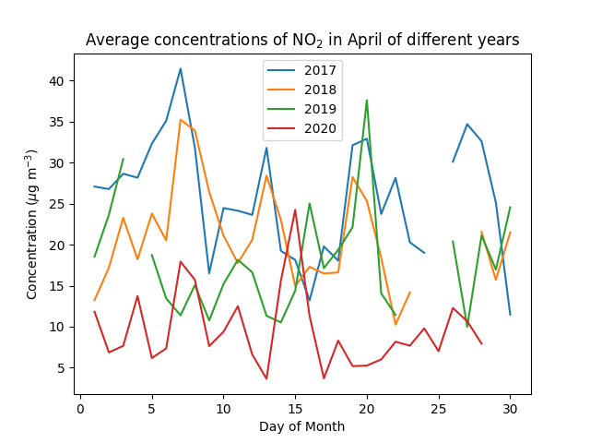
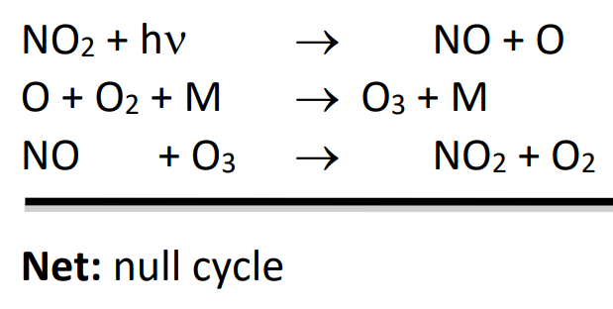
Today’s goals
How do concentrations of NO, NO₂, and O₃ vary by time of day?
Can we explain patterns and anomalies in the data?
Do the observed measurements match our simple models?

Slide 9
1. Plotting your first graph
Run the script provided using the command below. Unlike last week, we won’t provide an argument to say which file to plot - we will only use data from one file today.
python atmospheric.py
The script should run, and will create a graph from the file as a .png (which gets saved into your working directory, you can access the image in File Explorer).
I forgot to label the graph again - open atmospheric.py in Notepad++ and correct the axis labels, title and legend. Try to work out what is currently being plotted from the code, and find out the units by opening the data file “stoke.csv”.

Slide 10
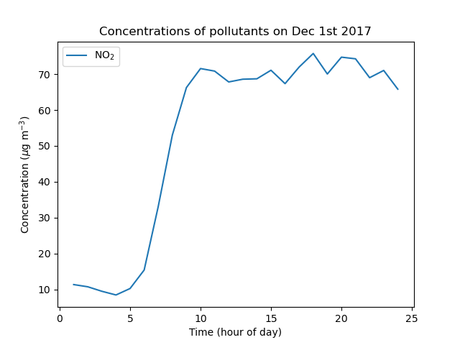
Plotting a graph
You should end up with a graph which looks something like this.

Slide 11
2. Plotting multiple data series
So far our graph only contains information about one pollutant.
By calling the function “plt.plot(...)” multiple times before we save the graph, we can plot multiple lines on the same graph.
Modify atmospheric.py to plot the concentration of all three pollutants, NO, NO₂, and O₃, on the same graph.

Slide 12
2. Plotting multiple data series
You should end up with a graph which looks something like this.
What causes the increase in NO₂ and then NO beginning at around 7 a.m.?
Why does the increase in NO and NO₂ result in the destruction of O₃?

Slide 13
2. Plotting multiple data series
Check with your neighbours that you’ve got the same graph.
Then each pick a different day in December, and plot the concentrations of all three pollutants throughout the day and compare again with your neighbour. What do you notice?

Slide 14
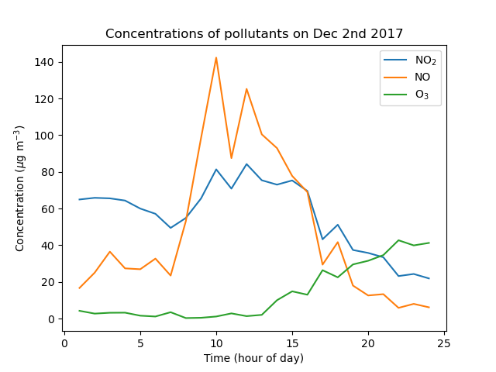
2. Plotting multiple data series
The trend for NO is similar here, but the trend for NO₂ and O₃ is quite different. To get a better overall picture, we need an average.

Slide 15
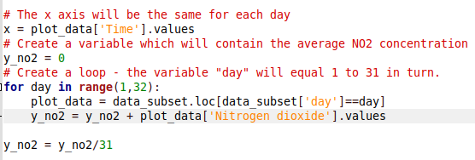
3. Plotting averaged data
Take a look at the code headed “plotting a second graph”.
This code prepares the x and y variables we need to plot the average NO2 emissions at each time of day during December.
Copy the code which creates and decorates your first graph, and paste it below this section of code, to plot the average NO₂ concentration at each time of day.

Slide 16
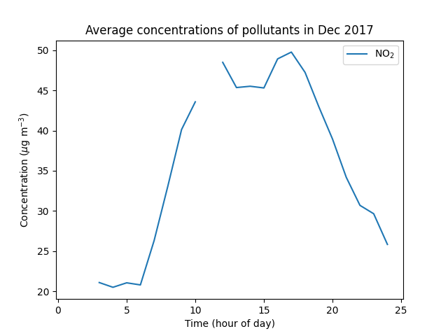
3. Plotting averaged data
One point is missing, because some raw data is missing! This is common when we use real-life data - maybe the instrument was broken that day?

Slide 17
3. Plotting averaged data
Now try to modify the code to also plot the average concentration of ozone and nitric oxide at each time during the day.
Use the existing code as a template.
Create new variables to store the average concentration of NO and O₃.
Plot these new variables on the graph before you save it.

Slide 18
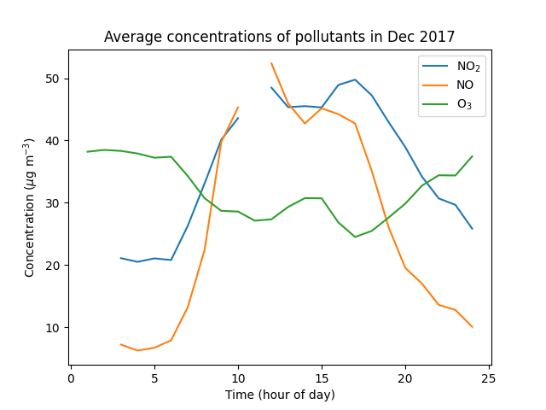
3. Plotting averaged data
This averaged data is easier to understand than a single day’s data. We have a peak in NO_{x} concentration at around 10 a.m. and 4 p.m. corresponding with dips in the ozone concentration.

Slide 19
3. Plotting averaged data
Let’s make a third graph, which instead of plotting the average pollution at each time of day, plots the average pollution on each day in December 2017.
To create this graph, you should:
Copy the code you used to create your second graph and paste it below the comment “plotting our third graph” - this will be the starting point.
Modify the variable x. This should contain the days of month, which are the same at every time of day.
Modify the “for” loop. We want to average over each hour of the day.
Modify the variable “plot_data”. Each time we go through the loop, we want it to equal the dataset at a different time of day.
Modify the x axis label and title of the graph.

Slide 20
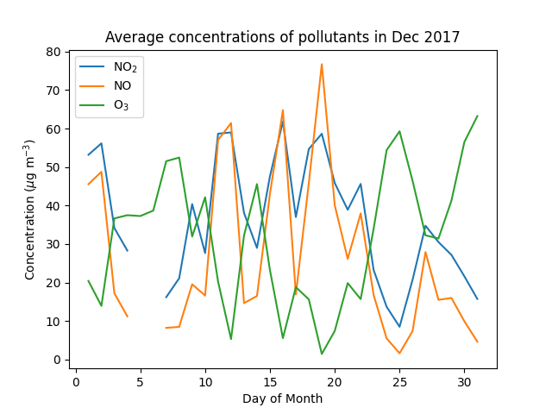
3. Plotting averaged data
Are there any trends or observations which stand out from this data?

Slide 21
4. The effect of COVID.
For the final graph, put together the tools you’ve used so far to plot the average concentration of NO₂ on each day of April of 2017 and on each day of April 2020.
Note that you’ll need to select different subsets of the data to do this - look back to the start of the code used to create the first graph to see how to do this.
If you want an extra challenge, write an extra “for” loop so that you plot the average concentration of NO₂ on each day of April from every year from 2017 to 2020.

Slide 22
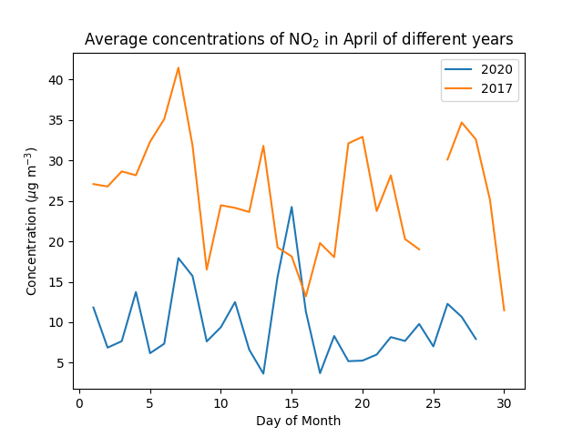
4. The effect of COVID.

Slide 23
Google Survey
If participating, please now go back to the survey and fill in the next section. Thanks very much for your help!

